Slide 1
How to upload ppt and video files on eTL
Part II

Slide 2
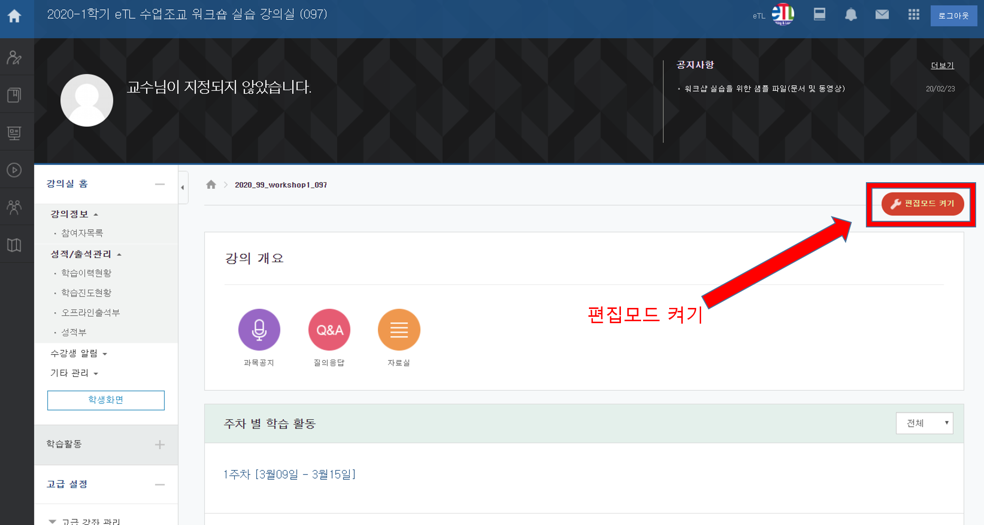
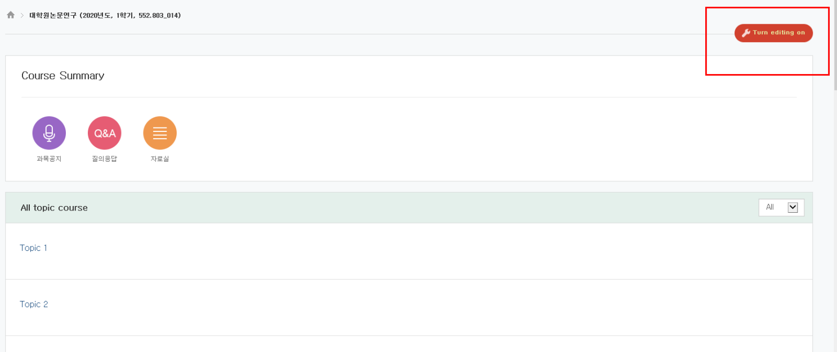
1. How to upload ppt files on eTL
① Click [Turning on the Editing Mode].
Notes:
This is about how to upload the ppt(powerpoint) files on eTL
To upload ppt files, you need to go to the course home and click [Turning on the Editing Mode]

Slide 3
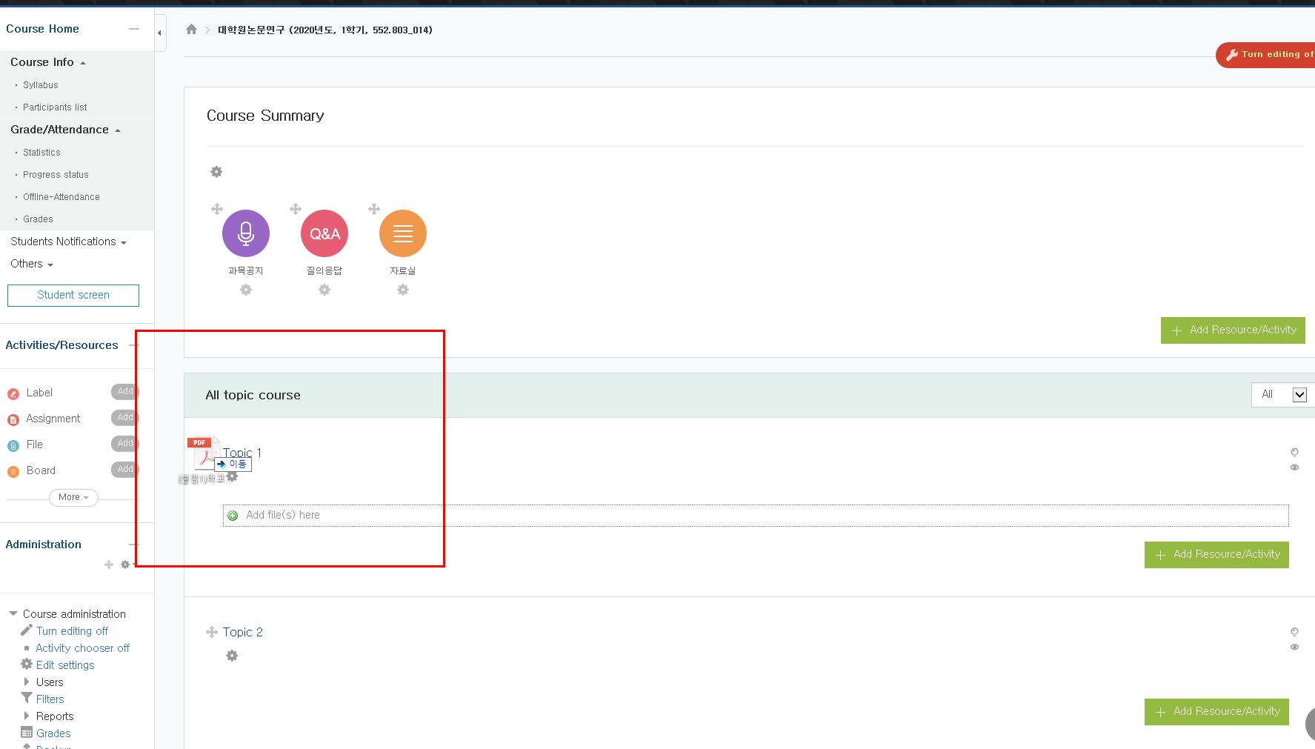
1. How to upload ppt files on eTL
② Click [Turning on the Editing Mode] and drag your ppt files.
Notes:
When the [Editing Mode] is on, drag and drop your ppt files.

Slide 4
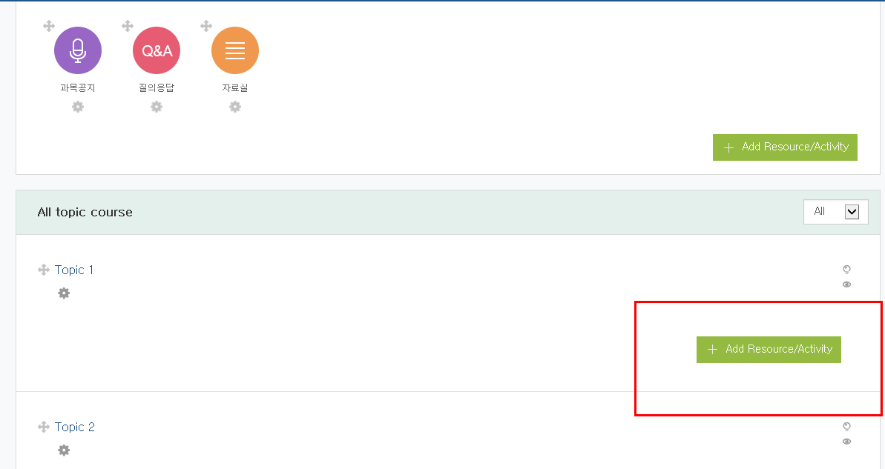
2. How to upload video that can check process
① Click [Turning on the Editing Mode]
② Click [Additional Materials and Activities]
Notes:
Click the [Additional materials and activities(자료 활동 및 추가)].

Slide 5
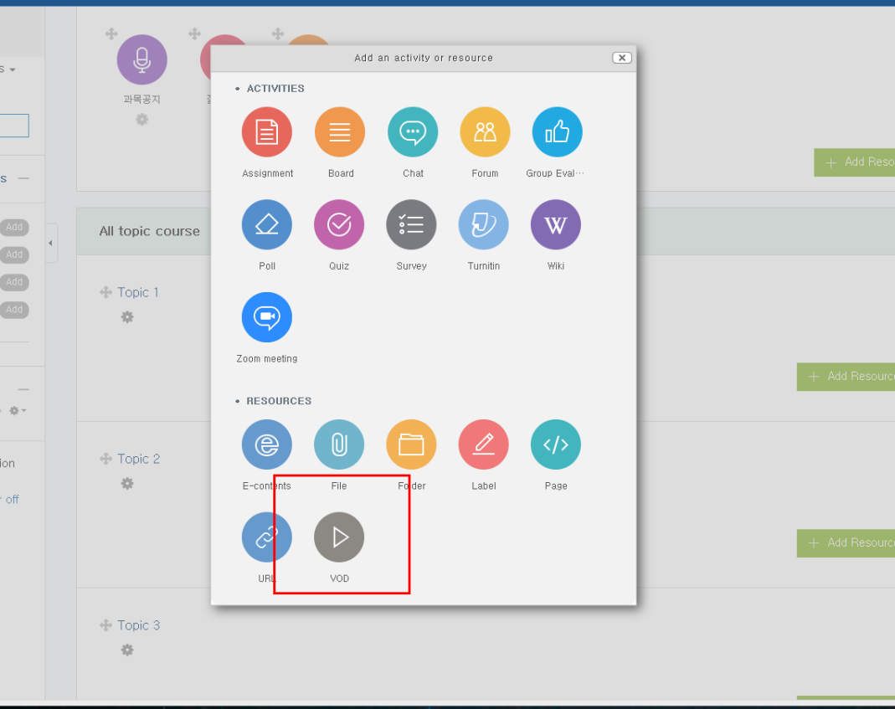
2. How to upload video that can check process
③ Click [Video]

Slide 6
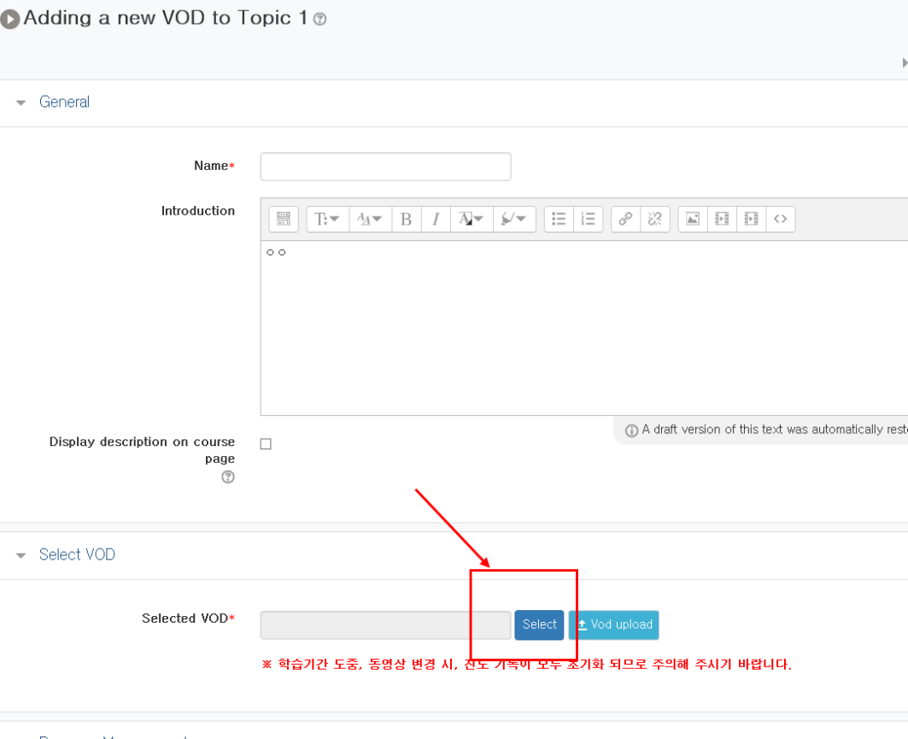
2. How to upload video that can check process
④ Click [Select Data]

Slide 7
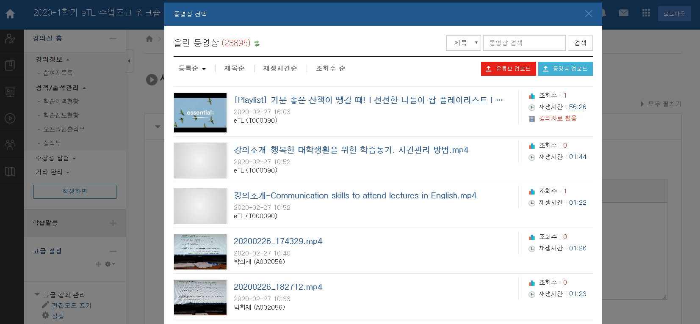
2. How to upload video that can check process
⑤ Click Uploaded Video or [Upload Video]

Slide 8
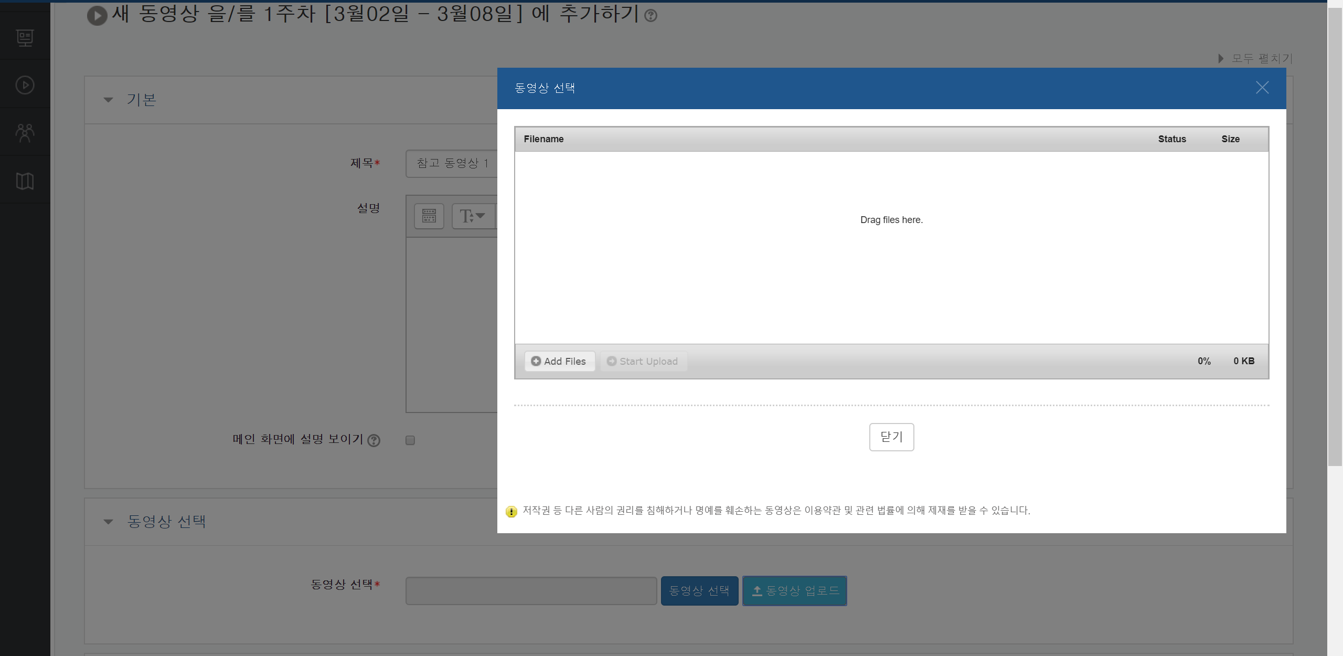
2. How to upload video that can check process
⑥ Add Files ⇒ Start Upload

Slide 9
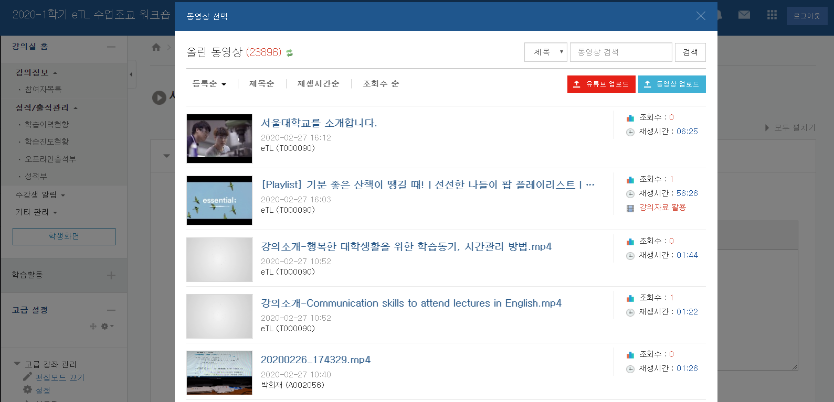
2. How to upload video that can check process
New file uploaded

Slide 10
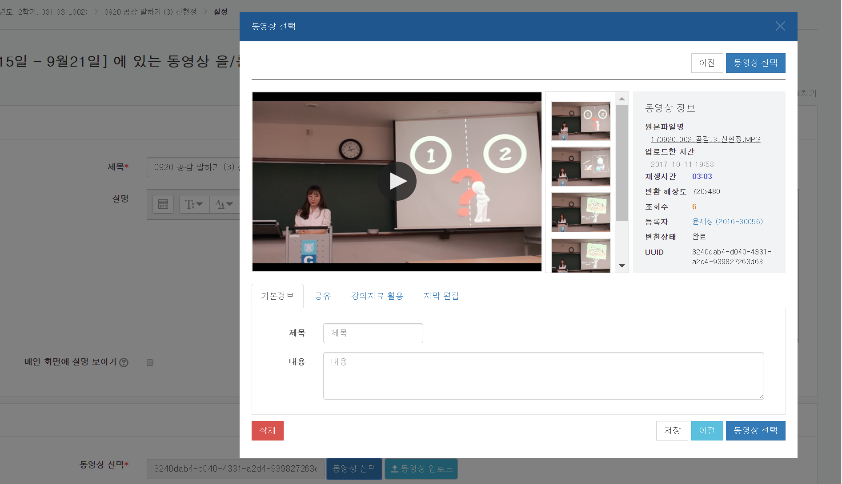
2. How to upload video that can check process
⑦ Enter a title, click [select video] and save it ( you don’t need to wait for conversion).

Slide 11
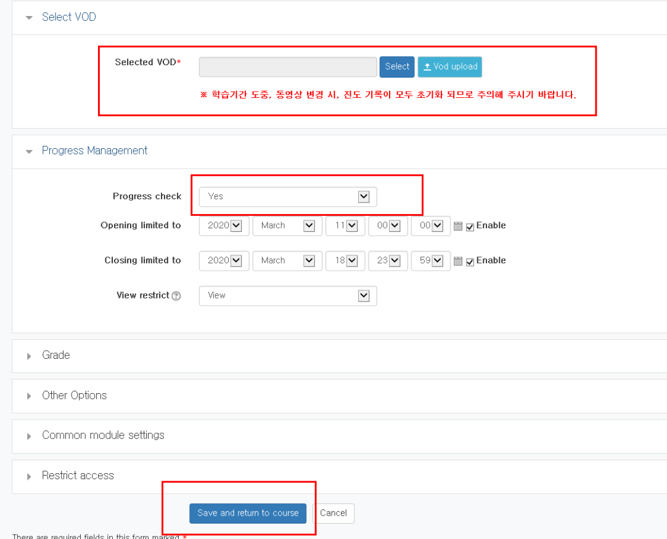
2. How to upload video that can check process
⑧ Check the file is uploaded, the [process check] box is marked “yes”, the start and end time. And save it.

Slide 12
2. How to upload video that can check process
⑨ Student: Watch the Video

Slide 13
2. How to upload video that can check process
⑩ Lecturer: You can check students’ progress
Click [Grades/Attendance Management]=>[Learning Progess]

Slide 14
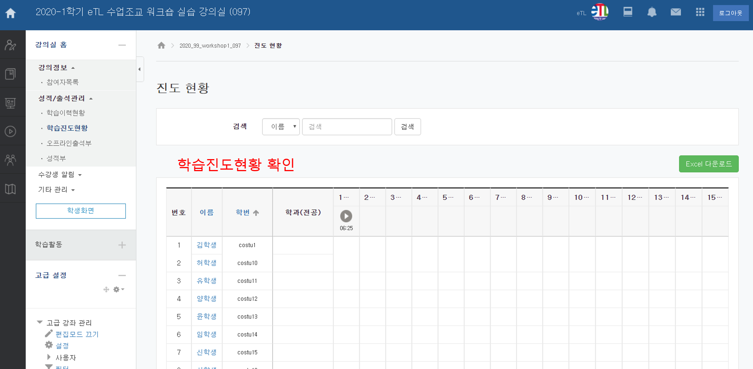
2. How to upload video that can check process
⑪ Lecturer: To check the details(when the student watched the video, how many times, etc), click the student’s name

Slide 15
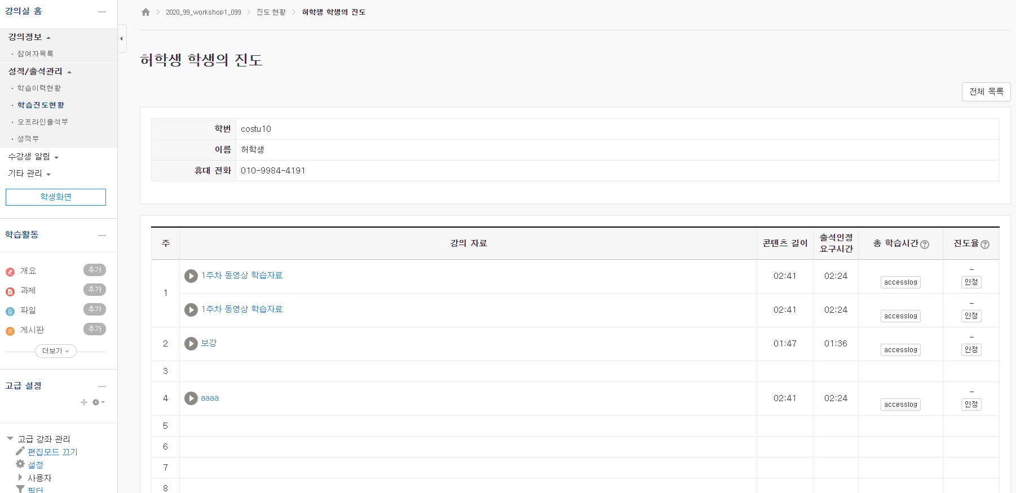
2. How to upload video that can check process

